Slide 1


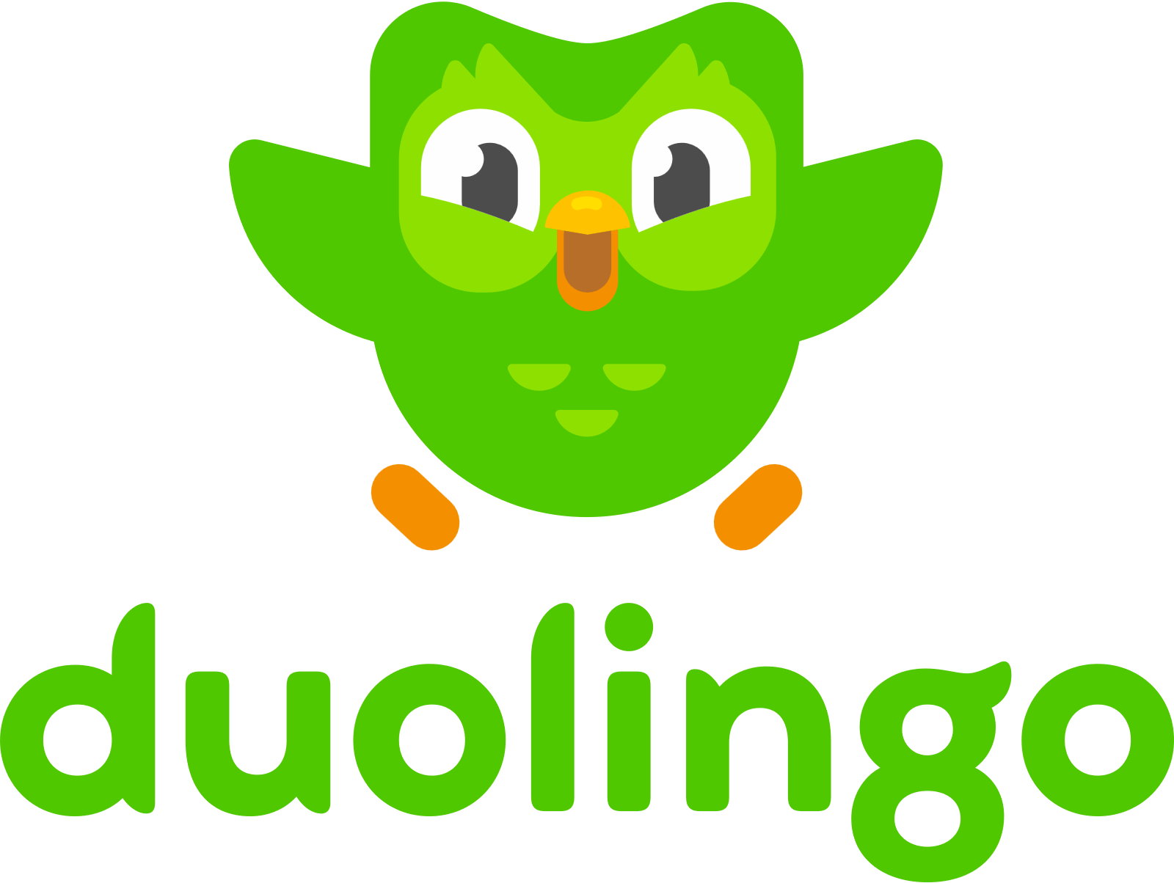
Duolingo’s Language Learning Model: A Systematic Review
CIS9440 Data Warehousing and Analytics
Spring 2022
Selected slides from original class presentation created by Vivian Kwong

Slide 2
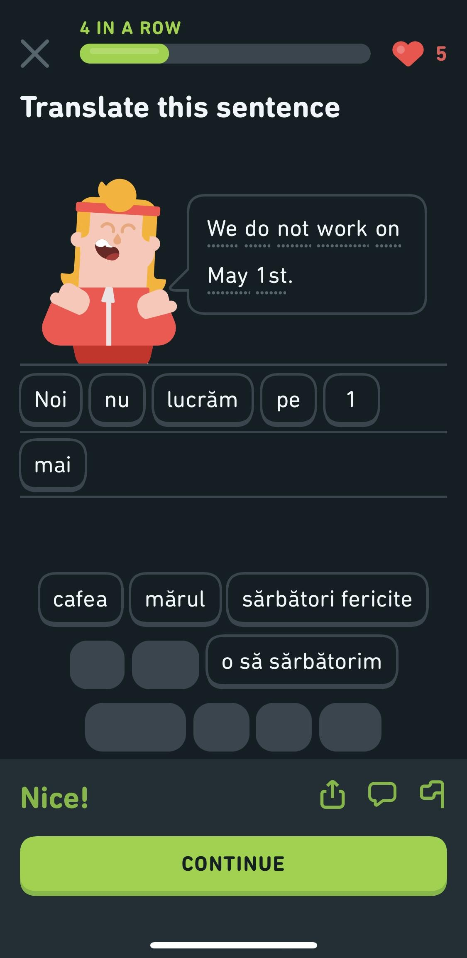
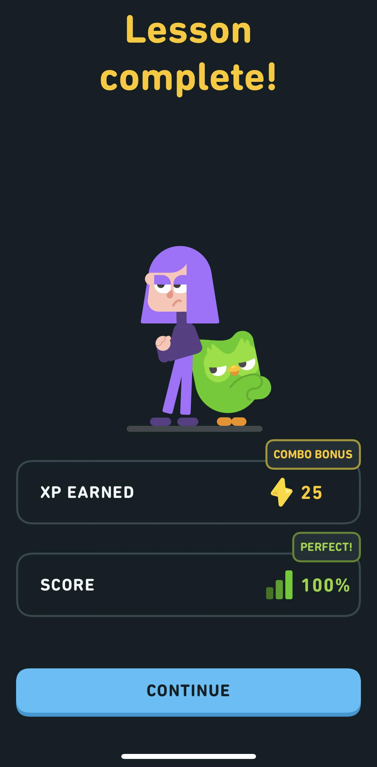

Introduction - Duolingo
Is the #1 language-learning app in the world
Is known for its gamification of language learning by making users compete against each other in leagues to earn the most XP
Uses spaced repetition model to predict when a user has forgotten a word or concept and to select which challenges it will put into a session

Slide 3




Data Sources
Main dataset from Harvard Dataverse
12 attributes
12,854,226 learning traces (i.e., observations)
Recorded over two weeks in 2013
Published by Duolingo for research purposes
Lexeme reference text file from GitHub
Reference file for part of speech and modifier component tags in the main dataset
Published by Duolingo for the main dataset

Slide 4

Dataset Attributes
p_recall - proportion of exercises from this lesson where the word was correctly recalled
timestamp - UNIX timestamp of the current lesson
delta - time (in seconds) since the last lesson that included this word
user_id - student user ID who did the lesson (anonymized)
learning_language - language being learned
ui_language - user interface language (presumably native to the student)
lexeme_id - system ID for the word
lexeme_string - information about the word in the form of tags: surface form, lemma, part of speech and morphological components
history_seen - total times user has seen the word prior to this lesson
history_correct - total times user has been correct for the word prior to this lesson
session_seen - times the user saw the word during this lesson
session_correct - times the user got the word correct during this lesson

Slide 5
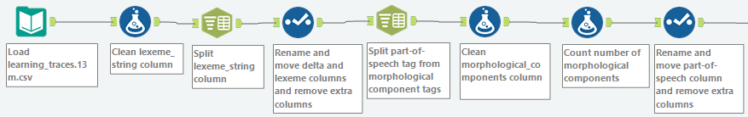
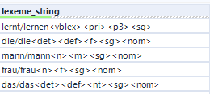
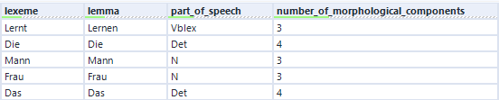

ETL – Extraction and Transformation
After extracting the CSV file, we focused on the lexeme_string attribute in the dataset
This attribute has information about the word in the form of tags: the surface form, lemma, part of speech and morphological components
We separated the lexeme (i.e., surface form), lemma and part-of-speech tags and created an attribute for the number of morphological components we see, which is one of our proxies to measure the difficulty of a word

Slide 6
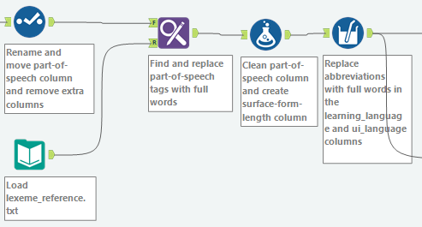

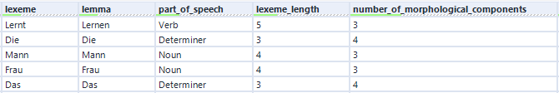

ETL – Transformation
After bringing in the lexeme_reference text file, we replaced the part-of-speech tags with something more understandable
We then created an attribute for the number of characters of the surface form (i.e., “lexeme_length”), which is another one of our proxies to measure the difficulty of a word
We also replaced all language abbreviations with the full names of the languages

Slide 7
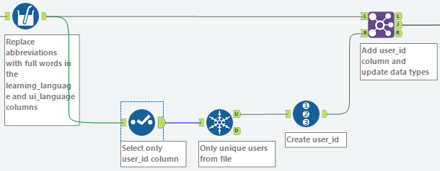
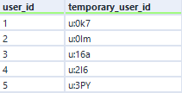
ETL – Transformation
We noticed that the User IDs in the dataset were case sensitive (e.g., “u:FO” and “U:fo” would be considered different users)
To take care of any possible case insensitivity issues later on in the project, we created our own user_id attribute to use going forward

Slide 8
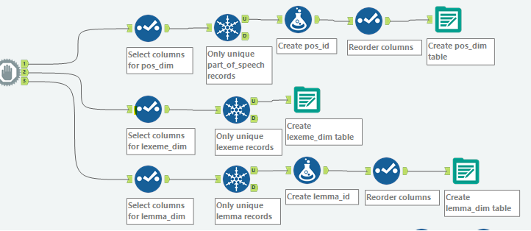
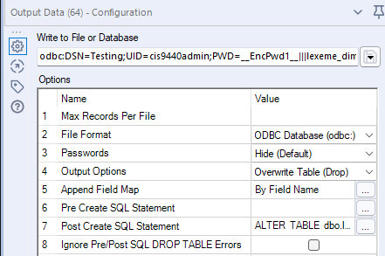
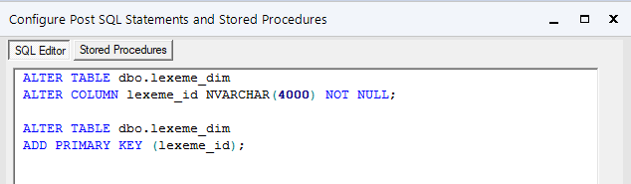
ETL – Loading Dimension Tables
We used a Block Until Done Tool to organize the order in which the tables were created
For any dimensions that did not already have an ID attribute in the dataset, we created an ID attribute to serve as the Primary Key
We used the “Post Create SQL Statement” option in the Output Data Tool to designate the Primary Key for each dimension and then loaded each table to the database

Slide 9
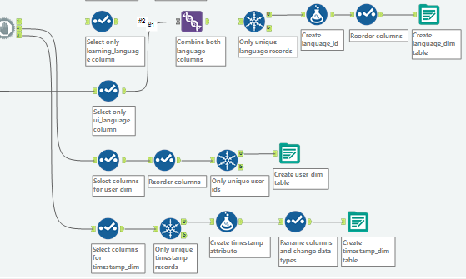
ETL – Loading Dimension Tables
For the language dimension, we had to use the Union Tool to include both the user interface languages and the learning languages in the same dimension before applying the same steps as for creating the other dimension tables
For the timestamp dimension, we had to convert the timestamps from UNIX to a DateTime data type before applying the same steps as for creating the other dimension tables

Slide 10
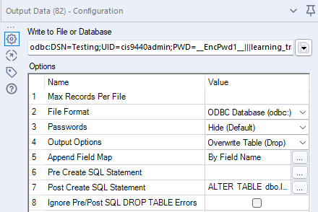
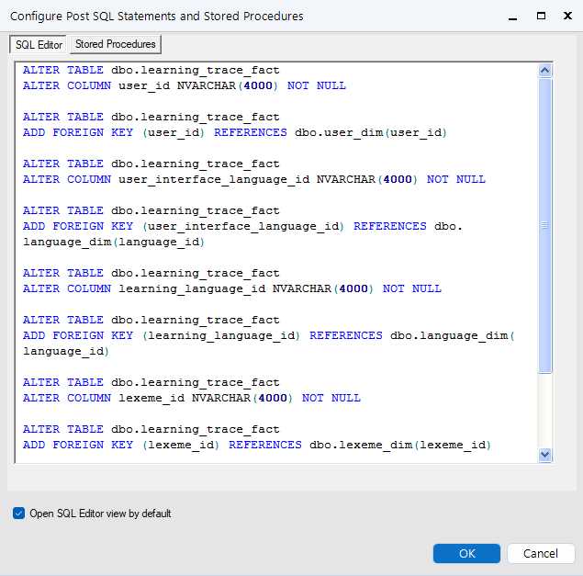
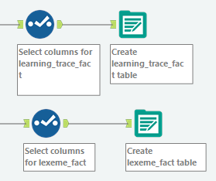
ETL – Loading Fact Tables
For both fact tables, we only needed to select the attributes that should be included in the fact tables, and then we loaded the fact tables to the database
We used the “Post Create SQL Statement” option in the Output Data Tool to designate the Foreign Keys for each fact table

Slide 11
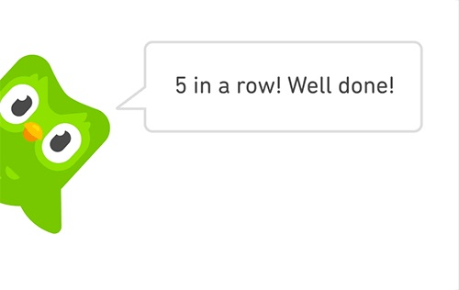
Thank you! Any questions?

Slide 12
References
Aims and scope. Taylor & Francis Online. Retrieved May 8, 2022, from https://www.tandfonline.com/action/journalInformation?show=aimsScope&journalCode=ncal20
Blanco, C. (2021, December 6). The 2021 Duolingo Language Report. Duolingo Blog. https://blog.duolingo.com/2021-duolingo-language-report/
Protalinkski, E. (2020, August 18). How Duolingo uses AI in every part of its app. VentureBeat. https://venturebeat.com/2020/08/18/how-duolingo-uses-ai-in-every-part-of-its-app/
Settles, B. (2017a). Halflife-Regression. Github. https://github.com/duolingo/halflife-regression
Settles, B. (2017b). Replication Data for: A Trainable Spaced Repetition Model for Language Learning (V1) [Data set]. Harvard Dataverse. DOI: 10.7910/DVN/N8XJME

